Slide 1
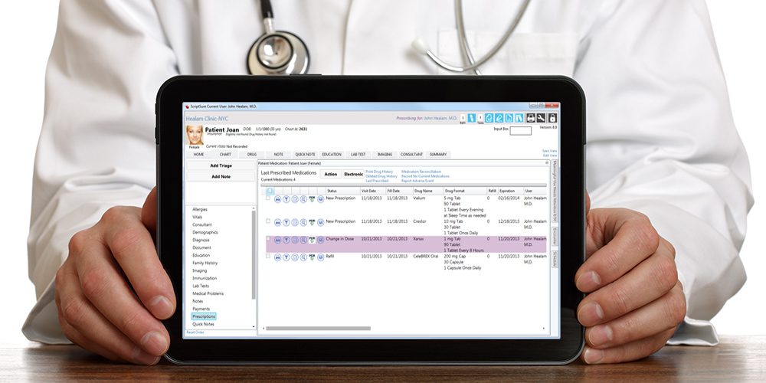
Electronic Medical Prescription
Département Informatique

Slide 2
I. INTRODUCTION
Medication errors are the most common type of medical errors in health care.
Errors such as improper dose of medicine, adverse drug interactions, food interactions, etc.
solotion proposed : e-prescription
Electronic prescriptions which are recently gaining attention in the e-health domain, are one of the solutions proposed to solve these type of errors.
In an e-prescription system, prescriber electronically sends an accurate, error-free prescription directly to a pharmacy from the point-of-care.

Slide 3
Supporting
During the recent years, the adoption of e-prescriptions has been spreading relatively rapidly.
In the US, the so called Electronic Prescribing Incentive Program:
  is a reporting program that uses a combination of incentive payments and payment adjustments to encourage electronic prescribing
The Canadian Medical Association (CMA) and the Canadian Pharmacists Association (CPhA) :
  have approved a joint statement on the future of e-prescribing that aims to have all prescriptions for Canadians created, signed and transmitted electronically by 2015.

Slide 4
Problems
One of the main challenges in current e-prescription systems is dealing with the heterogeneity of available information sources.
Solution
Linked Open Data as an solution to interlink and integrate these isolated sources of information is obtaining more attention in the domain of pharmaceutical, medical and life sciences.

Slide 5
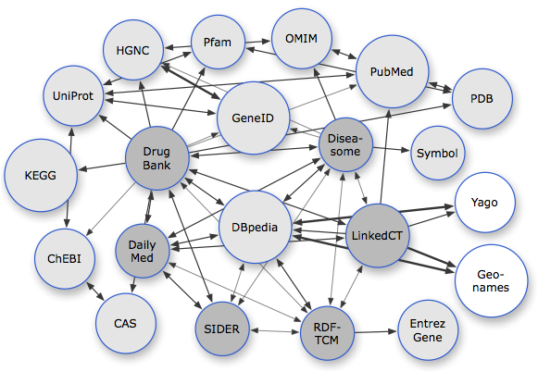
Solution
Semantic prescriptions as introduced in this paper are a proposed approach to utilize semantic web technologies in e-prescription systems.
>Fig. 1. Available datasets related to pharmaceutical research.’

Slide 6
II. LINKED OPEN DATA
In computing, Linked Data describes a method of publishing structured data so that it can be interlinked and become more useful.
A. Linked Open Drug Data (LODD)
Particularly in the areas of health care and life sciences contributed to the development of the Linked Open Data effort and made social and technical contributions towards data integration, knowledge management, and knowledge discovery.

Slide 7
B. LODD Applications in Medical Domain
There exists few approaches that address the medical and pharmaceutical applications using LODD.
TripleMap and PHACTS (Pharmacological Concept Triple Store) are projects connecting widespread distribution of journal articles patents and numerous databases in pharmaceutics research.

Slide 8
III. SEMANTIC CONTENT AUTHORING
A Semantic Document is an intelligent document which “knows about” its own content so that it can be automatically processed in unforeseen ways. Semantic documents facilitate a number of important aspects of information management.
V. PHARMER: SEMANTIC AUTHORING OF MEDICAL PRESCRIPTIONS
Semantic Medical Prescriptions are intelligent e prescription documents enriched by dynamic drug-related meta-data
best example for semantic prescriptions is a application called Pharmer which provides a platform for semantically annotation of conventional prescriptions

Slide 9
Pharmer architecture
The Pharmer system architecture consists of three layers:
Document Layer: This layer includes the traditional eprescription document plus two components as Drug Detection and Drug Information Collector.
Semantic Layer: There are two main components in this layer namely Annotator and Authoring UI.
Application Layer: This layer provides a set of applications on top of the generated semantic prescriptions.

Slide 10
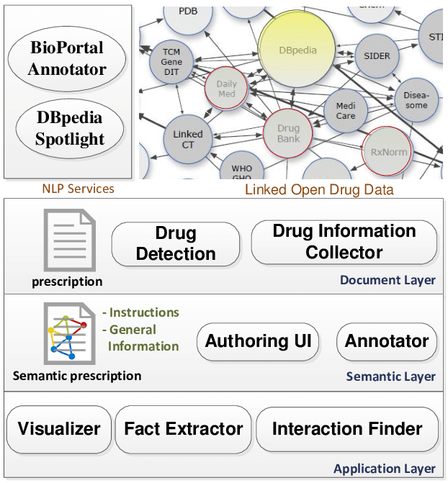
Pharmer architecture
Architecture of the Pharmer system.

Slide 11
ADVANTAGES
The main benefit of using semantic prescriptions is the persistent connection to up-to-date drug information coming from multiple dynamic data sources.

